Slide 1

ANALYZING HISTORIC OLYMPIC Athlete DATA
Maria Dong, Jess Izumi, Shalom Lee

Slide 2
Agenda
Introduction to the Data
Data Cleaning
Dashboard Presentation
Discussion & Conclusion

Slide 3
About the Data
Field | Desc.
ID | identifier
Name | athlete name
Sex | M/F
Age | in years
Height | in cm
Weight | in kg
Team | team name
NOC | National Olympic Committee code
Games | year & season
Year | year of games
Season | season of games
City | host city
Sport | name of sport
Event | name of event
Medal | medal won (if applicable)
Title: 120 Years of Olympic History
Source: Kaggle
270,000+ rows of data
Notes:
How many rows of data

Slide 4

What problems can we answer?
How have the Olympic participants evolved from 1896 to 2016?
How have games and competitors changed over time?
How do country affiliations affect competitor data?
Are there notable differences between Summer and Winter games?

Slide 5

Cleaning & Wrangling
Rename columns
Drop extraneous columns
Clean NA values
Factorize columns

Slide 6

Exploring our data
How do the following groups differ from each other?
Athlete stats (build, age, & gender)
Countries
Summer vs. Winter games
Medalists vs. Non-medalists
Years when games took place

Slide 7

Olympian Analysis

Slide 8









Conclusion & Next Steps
GO TEAM!!
Add 2018 Winter & 2021 Summer games
Determine future implications
Notes:
"characteristics" like being a host country, having more athletes, having a more centered height/weight

Slide 9

Questions?

Slide 10
Fun Facts
The first modern Olympics took place in 1896
The Olympics were only held in summer initially. The first winter games were held in 1924
The tradition of awarding gold, silver, and bronze medals was introduced in 1904
The U.S. has won the most medals throughout all of Olympic history
Women were first allowed to participate in the Olympics in 1900

Slide 11

Dashboard
Olympian Analysis

Slide 12
Observations - Demographics
Height vs. weight scatter plot | Age distribution | Total number of athletes over time
Males vs. females Medalists vs. all athletes | Before 1990 vs. 1990 and after Female increase Youngest vs. Oldest | General increase & female increase "Spikes" for host countries
Notes:
Height vs. weight scatter plot:
Predictably, male athletes tend to be taller and heavier than females.
The trendline of males is also steeper for all countries, showing that males are heavier per unit of height than females are.
For most countries, medalists' heights and weights are more condensed, suggesting that points furthest from the trendline are less likely to have won a medal.
Distribution of age by gender:
For most countries, the mean age of athletes has shifted upwards from "before 1990" to "1990 and after". Interestingly, two major countries that do not seem to have followed this trend are Russia and China.
All countries have increased their numbers of female athletes in "1990 and after" as opposed to "before 1990".
Female athletes tend to form the majority of the youngest athletes, whereas males tend to form the majority of the oldest athletes.
Number of athletes over time:
Most countries have increased their number of Olympic athletes per game over time.
Upward "spikes" in athlete numbers are often seen for host countries. See:
Brazil in Summer 2016,
Russia in Winter 2014,
the UK in Summer 2012,
China in Summer 2008,
and Italy in Winter 2006.
Again, the later rise in numbers of female athletes can be seen, but with more detail with regards to time.

Slide 13
Observations - Medals & Events
# of athletes vs. # of medals | Olympic events for selected year/season | Count of medals over time
Positive correlation USA | Greater variety Summer vs. winter | USA "Spikes" for host countries
Notes:
Number of athletes vs. number of medals scatter plot:
The two variables are positively correlated for all years of Olympic Games.
The USA is consistently at/near the top of the trendline, showing that they usually have one of the highest number of athletes and medals for that year's games.
Olympic events for selected year/season:
Over time, the number of events and categories of events have proliferated greatly.
There are significantly more Summer events than there are Winter.
"Athletics" has always been the largest category for the Summer Olympics.
Count of medals per country over time:
The USA has consistently been a top earner of medals.
The "spike" (as discussed previously in the demographics section) can again be seen with some host countries and number of medals won that year.
This is consistent with our previous finding that more athletes are correlated with more medals, and that host countries were likely to send more athletes than usual to the games they hosted.

Slide 14

Conclusions & Next Steps
Significant changes over time
Certain characteristics are more associated with earning medals
Add 2018 Sochi & 2021 Tokyo games
Determine future implications
Notes:
"characteristics" like being a host country, having more athletes, having a more centered height/weight

Slide 15
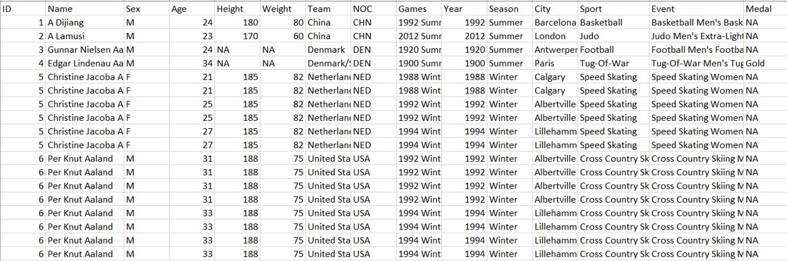
Data at a glance

Slide 16
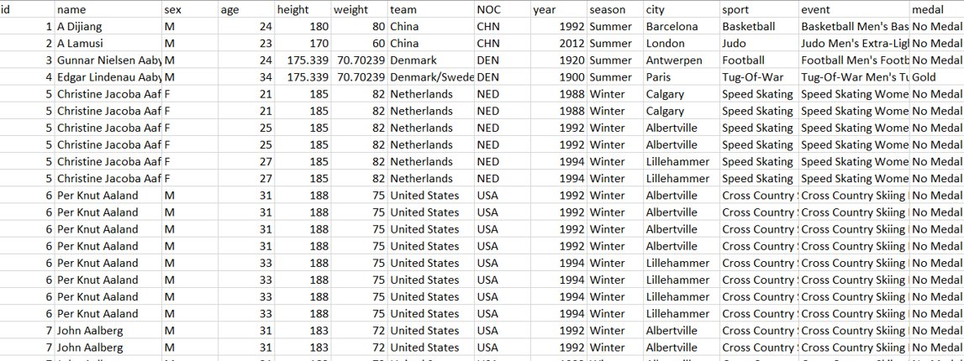
Cleaned data

